Slide 1
Dynamic Programming

Slide 2
This tutorial is built based on…
部分内容由张洳源老师正在编写的教材《认知行为的计算原理》收录：

Slide 3

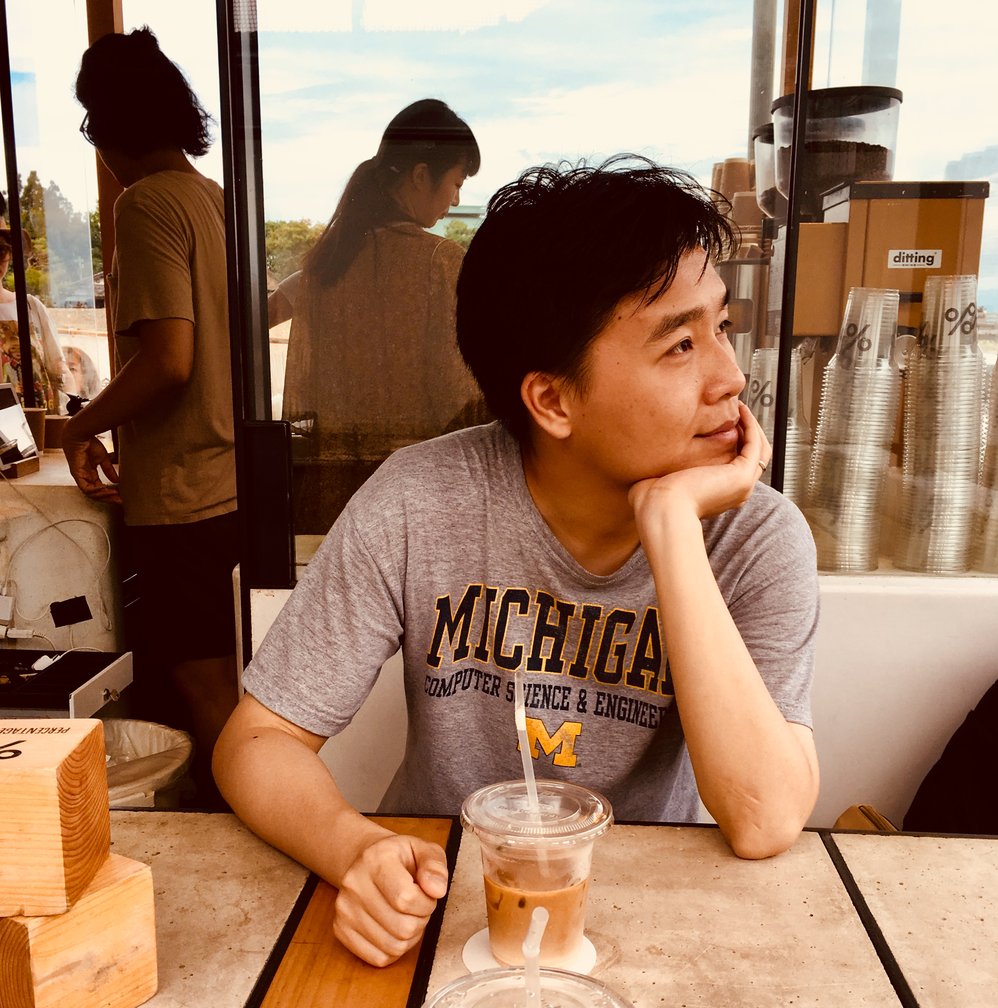




The motivation of this tutorial
CS285: Deep Reinforcement Learning
CS542: Statistical Reinforcement Learning
Shuhuai008: 强化学习
UCL course on RL: Reinforcement Learning
RL theory
Hugging face
Math & CS background
MindRL hub workshop
RW model in psychology & Neuroscience
Hands-on-practice
Progmmaing & computational resources
Q learning in psychology

Slide 4
What we might learn?
Understand that reinforcement learning extends beyond the Rescorla-Wagner model
Implement a classical reinforcement learning algorithms from scratch
Learn how to frame psychological problems within the reinforcement learning framework
Gain acquiantance with some cutting-edge content about planning

Slide 5
Overview
Lecture
Markov Decision Process (MDP)
State, action, reward, transition
Decision making on MDP
Goal, value, poilcy, Q value
Value evaluation
Bellman equation
Policy evaluation
Practice Policy evaluaton

Slide 6
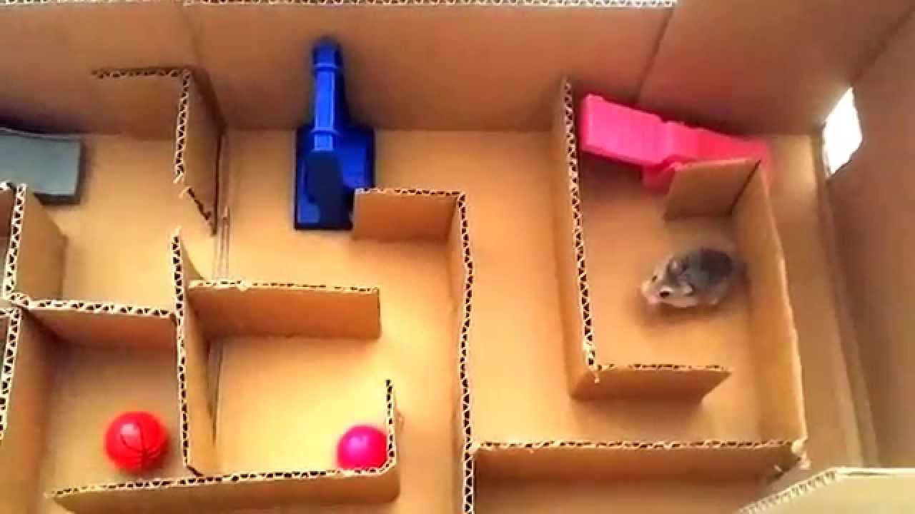

Slide 7
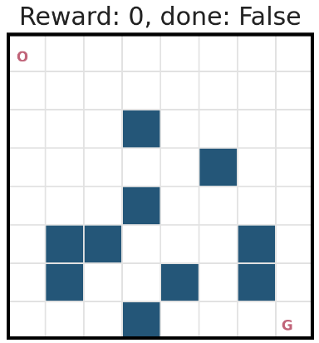
Frozen Lake
Reference:
https://github.com/udacity/deep-reinforcement-learning/blob/master/dynamic-programming/frozenlake.py
20% slippery rate

Slide 8
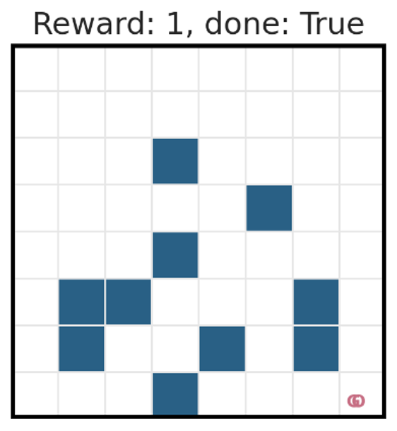
Frozen Lake
Reference:
https://github.com/udacity/deep-reinforcement-learning/blob/master/dynamic-programming/frozenlake.py

Slide 9
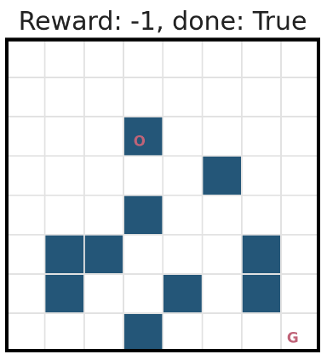
Frozen Lake
Reference:
https://github.com/udacity/deep-reinforcement-learning/blob/master/dynamic-programming/frozenlake.py

Slide 10
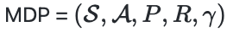
Markov decision process (MDP)
S_{t-1}
S_{t}
S_{t+1}
Why Markov property?
R_{t-1}
R_{t}
R_{t+1}
A_{t-1}
A_{t}
A_{t+1}

Slide 11
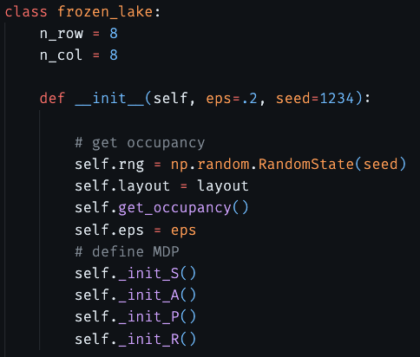
Markov decision process (MDP)

Slide 12
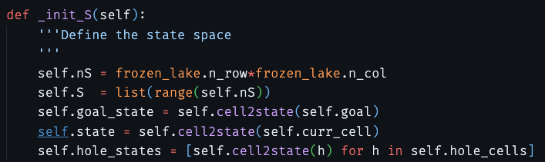
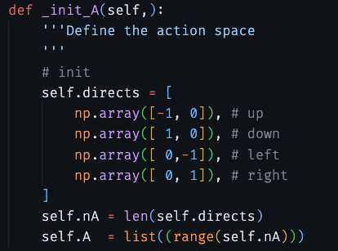
Markov decision process (MDP)

Slide 13
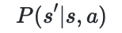
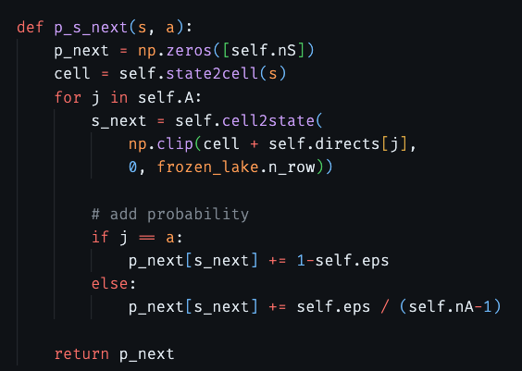
Markov decision process (MDP)

Slide 14
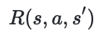
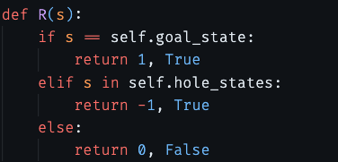
Markov decision process (MDP)

Slide 15
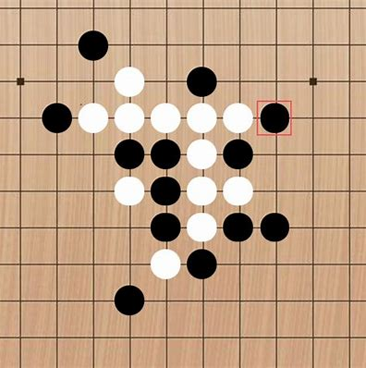
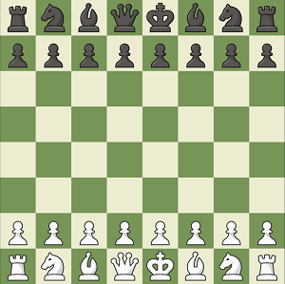

Markov decision process (MDP)

Slide 16
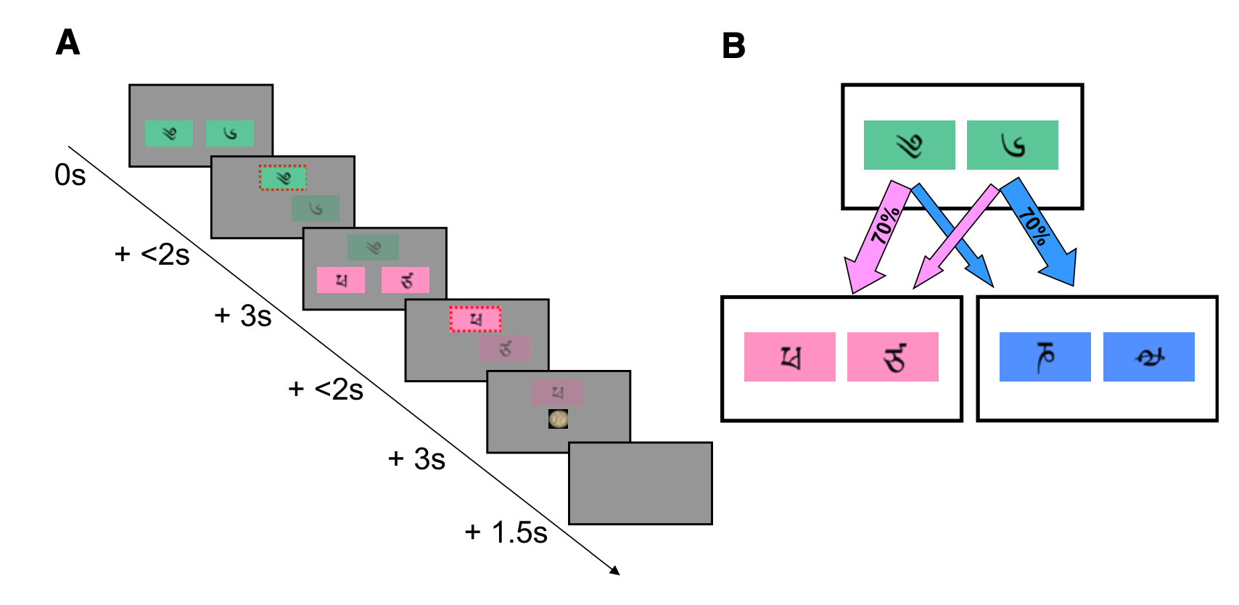
Markov decision process (MDP)
￥9
￥1
￥6
￥4
(Daw, 2011, Neuron)

Slide 17
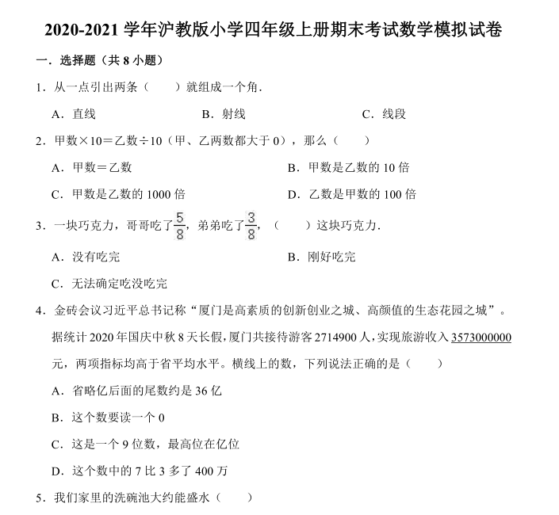
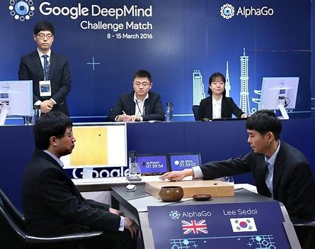
Goal

Slide 18
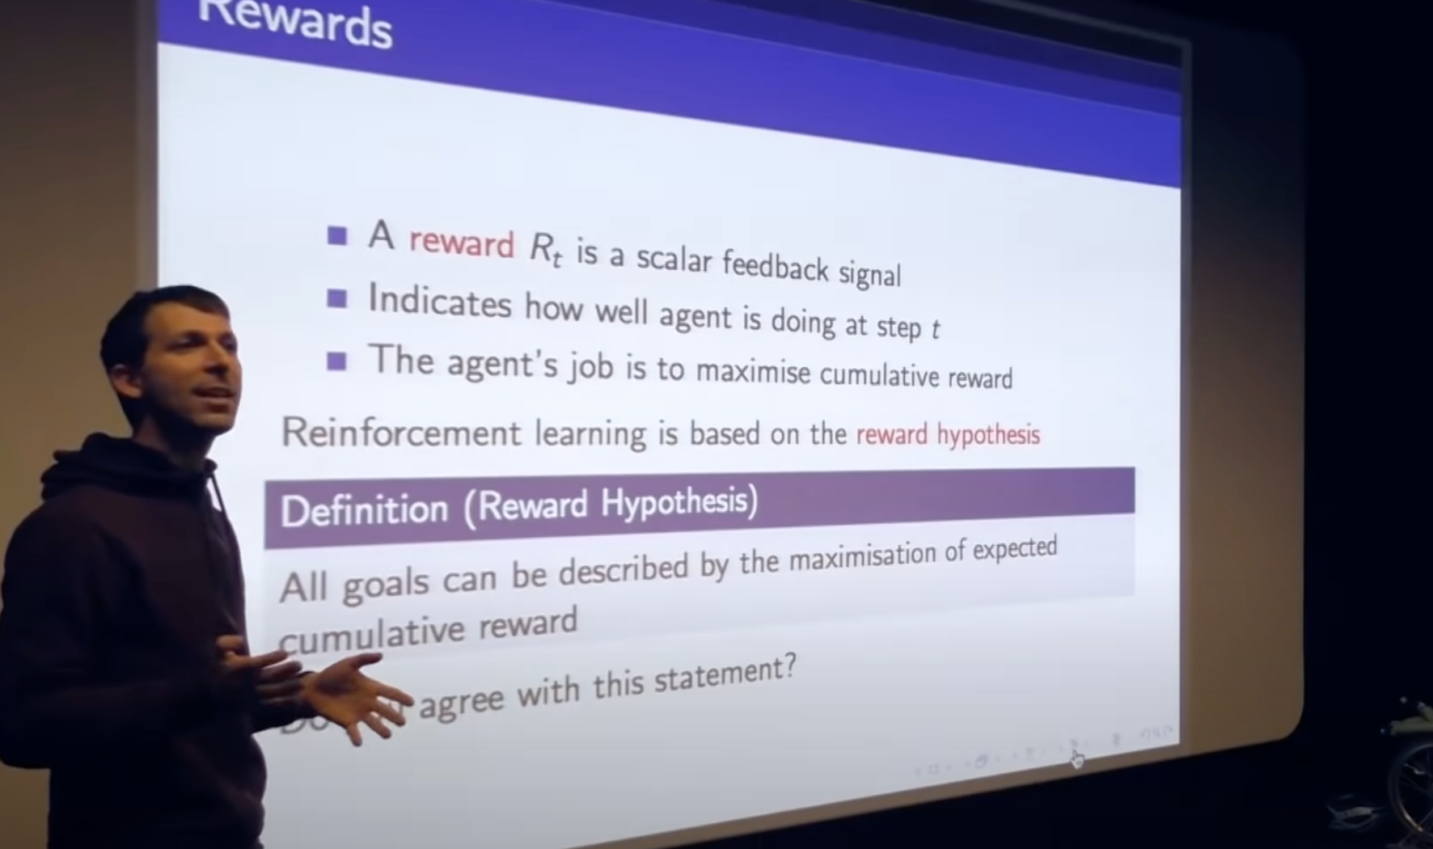
Goal: reward hypothesis
(Silver, 2022, Artificial Intelligence)

Slide 19
Cumulative reward
S_{t-1}
S_{t}
S_{t+1}
R_{t-1}
R_{t}
R_{t+1}
A_{t-1}
A_{t}
A_{t+1}

Slide 20
Expected cumulative reward
S_{t-1}
S_{t}
S_{t+1}
R_{t-1}
R_{t}
R_{t+1}
A_{t-1}
A_{t}
A_{t+1}

Slide 21
Value: expected cumulative reward at a given state
S_{t}
S_{t+1}
S_{t-1}=s
R_{t-1}
R_{t}
R_{t+1}
A_{t-1}
A_{t}
A_{t+1}

Slide 22
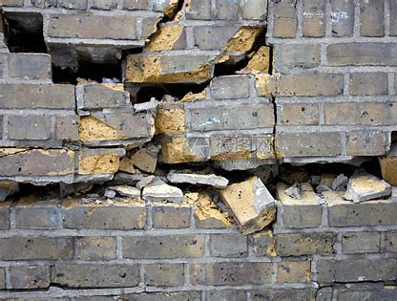
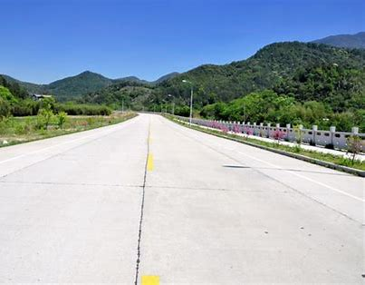
Value: expected cumulative reward at a given state
君子不立危墙之下

Slide 23
Policy
S_{t}
S_{t+1}
S_{t-1}=s
R_{t-1}
R_{t}
R_{t+1}
A_{t-1}
A_{t}
A_{t+1}
A policy maps a state to a distribution of actions

Slide 24
Goal: reward hypothesis

Slide 25
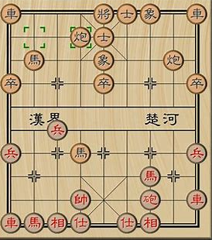
Value evaluation is not easy
要不要读博？
o

Slide 26
Bellman equation
S_{t}=s

Slide 27
Bellman equation
S_{t}=s
A_{t}

Slide 28
Bellman equation
S_{t}=s
S_{t+1}
R_{t}
A_{t}

Slide 29
Bellman equation
S_{t}=s
S_{t+1}
R_{t}
A_{t}

Slide 30
Bellman equation
Correct value evaluation should stasitfy this Bellman equation:

Slide 31
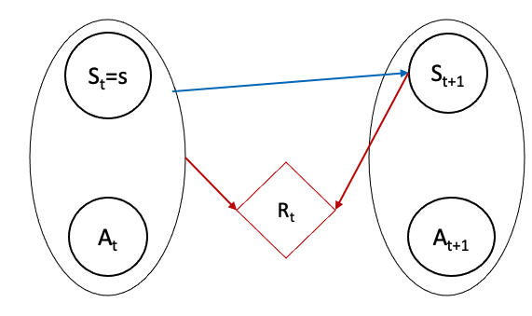
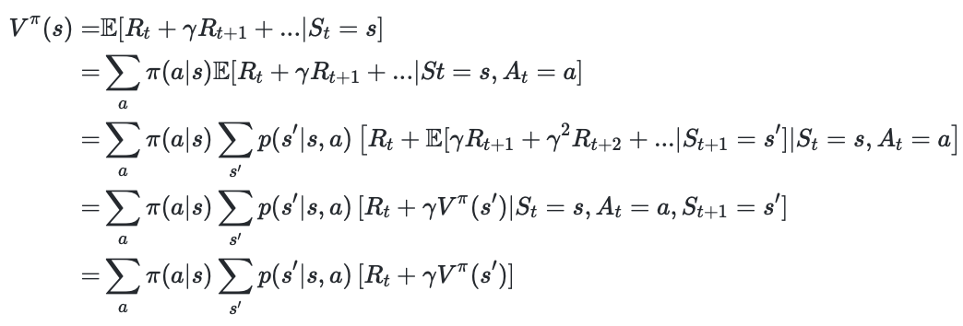
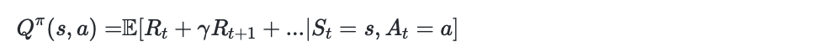
Q function: state-action value function
S_{t}=s
S_{t+1}
R_{t}
A_{t}

Slide 32
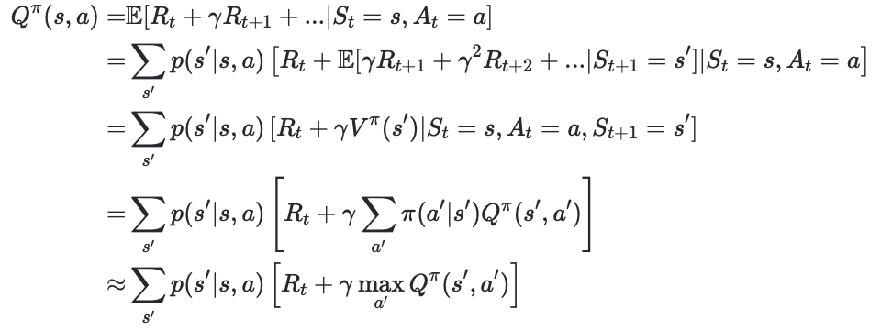
Q function: state-action value function
S_{t}=s
S_{t+1}
R_{t}
A_{t}

Slide 33
Q function: state-action value function
S_{t}=s
S_{t+1}
R_{t}
A_{t}

Slide 34
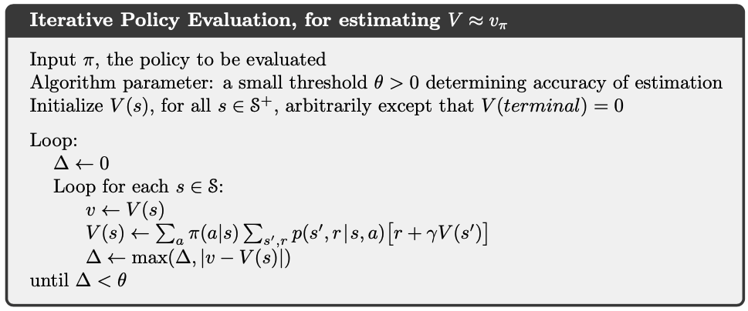

Dynamic programming: policy evaluation

Slide 35
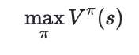
Reward hypothesis

Slide 36
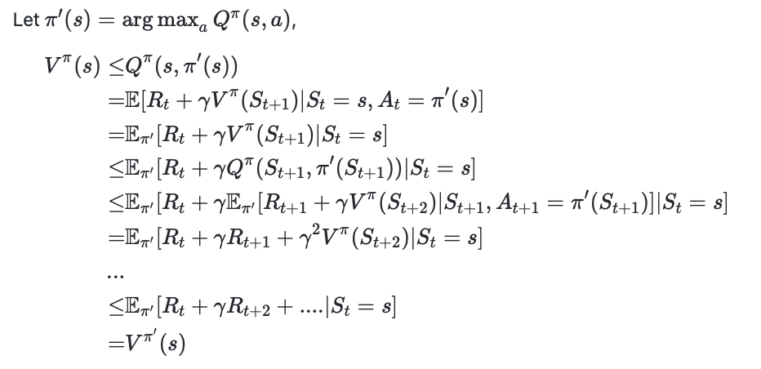
Policy improvement

Slide 37
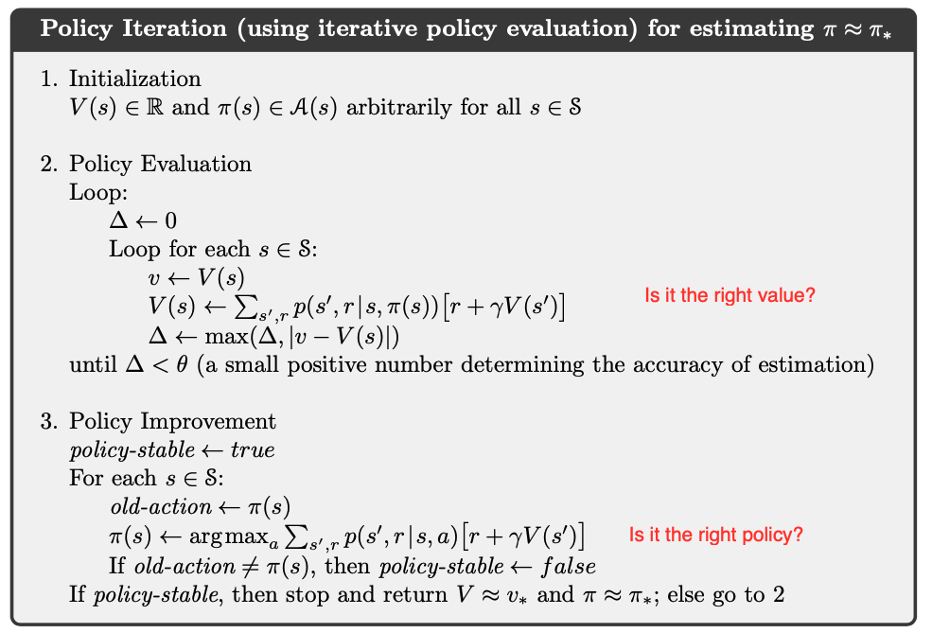
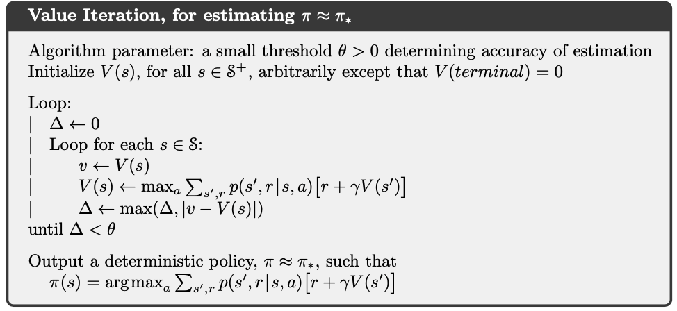
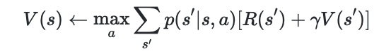
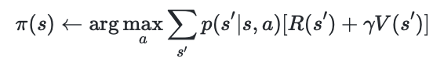
Policy improvement

Slide 38
Value iteration

Slide 39
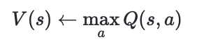
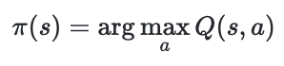
From value to Q function

Slide 40
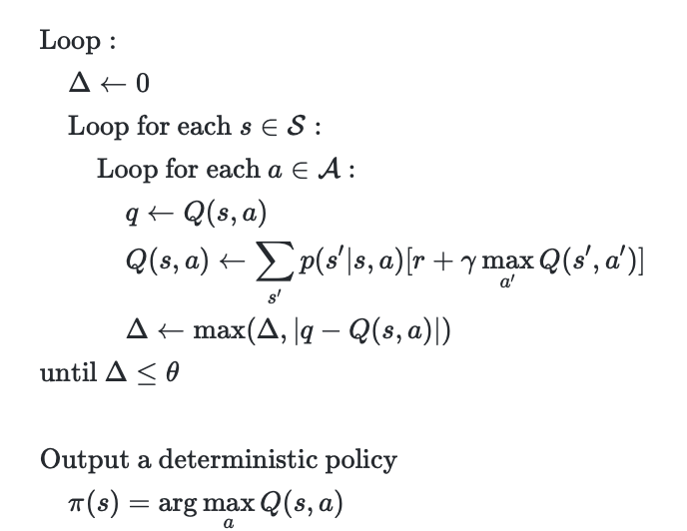
Q function Iteration

Slide 41
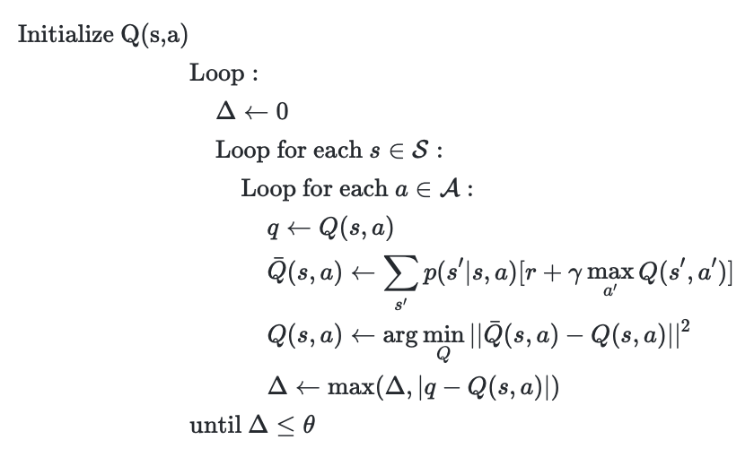
Another persepctive

Slide 42
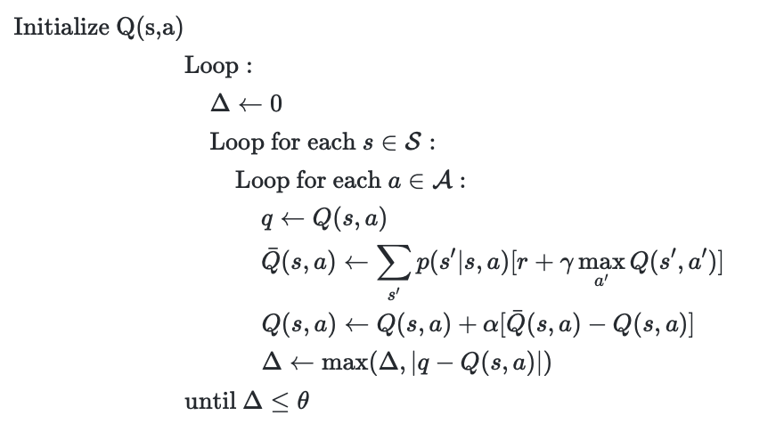
When estimation is not accurate

Slide 43
What’s wrong with dynamic programming
The state and action space can be huge
We do not always know the transition function and reward fucntion

Slide 44
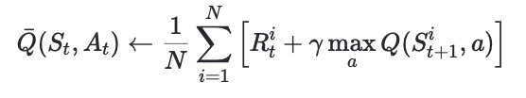
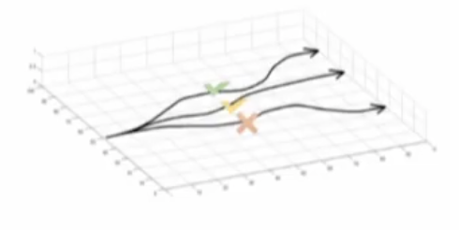
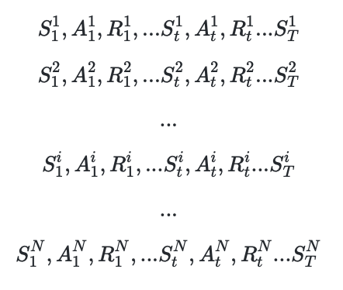
Sampling as a solution

Slide 45
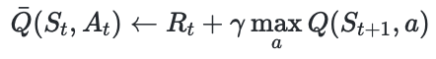
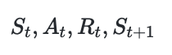
Get one sample

Slide 46
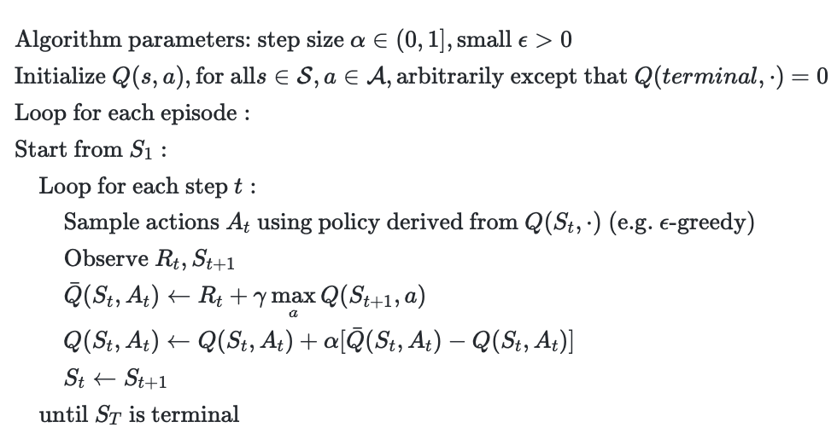
TD learning (Q learning)

